Slide 1

Monetary and bank system of England and PMR

Slide 3

Pridnestrovian is the only unrecognised state entity in the post-Soviet space that managed to create its own self-sufficient monetary system

Slide 4
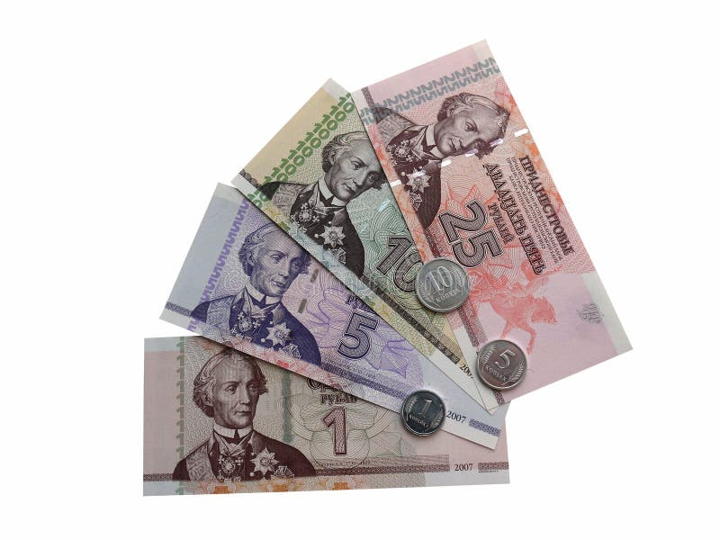
Monetary system of
PMR

Slide 5

August 1994 was marked by an important event in the history of our young republic - the introduction into circulation of the national currency - the Pridnestrovian rouble. It became one of the symbols of statehood of the independent Pridnestrovian Moldovan Republic. The national monetary unit fulfils all the functions assigned to it - it is a means of circulation, acts as a measure of value and serves as a means of saving for the population of Pridnestrovian. The financial and banking system, which is vital for the country, has been formed on its basis.

Slide 6

Bank system of
PMR

Slide 7

The banking system of Pridnestrovian as an independent state began to emerge at the end of 1992. It consists of two levels: the Pridnestrovian Republican Bank and commercial banks.

Slide 8

Pridnestrovian Republican Bank
Pridnestrovian Republican Bank (PRB), Bank of Pridnestrovian - is the central bank of the PMR. Monetary emission is carried out exclusively by the central bank of the state within the limits established by the Supreme Council of the Pridnestrovian Moldovan Republic when adopting the budget in the interests of state regulation and development of the economy of the Republic.

Slide 9



Commercial banks of Pridnestrovian:
Pridnestrovian Savings Bank
One of the largest commercial banks and the only bank in the PMR that has a state guarantee of safety and return of citizens' deposits
One of the largest commercial banks of the Pridnestrovian Moldavian Republic. The Bank has established an extensive branch network
Agroprombank
EximBank
It is the main creditor of the enterprises of gas industry, trade, light industry. The bank's branch network is located in all key districts of Pridnestrovian.

Slide 10

The economy of England is the largest economy of the four countries of the United Kingdom. England's economy is one of the largest and most dynamic in the world, with an average GDP per capita of £34,690 in 2021.

Slide 11
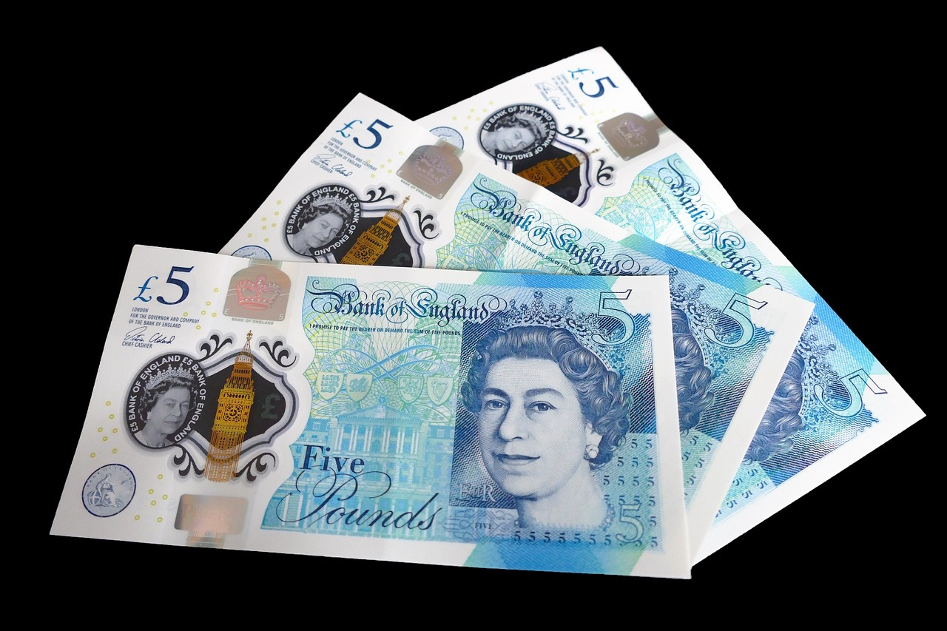
Monetary system of
England

Slide 12

England currency is called the pound, and the symbol is £. It is similar to American currency, as they have paper money and money made of metal, or coins. There are 100 pence in a pound, and coins come in denominations of 1 penny (singular form of pence), 2, 5, 10, and 20 pence. The pound sterling is one of the oldest currencies in the world and plays a significant role in international financial transactions

Slide 13

Bank system of
England

Slide 14

The bank system of England consists of two levels: The Bank of England and commercial banks.

Slide 15
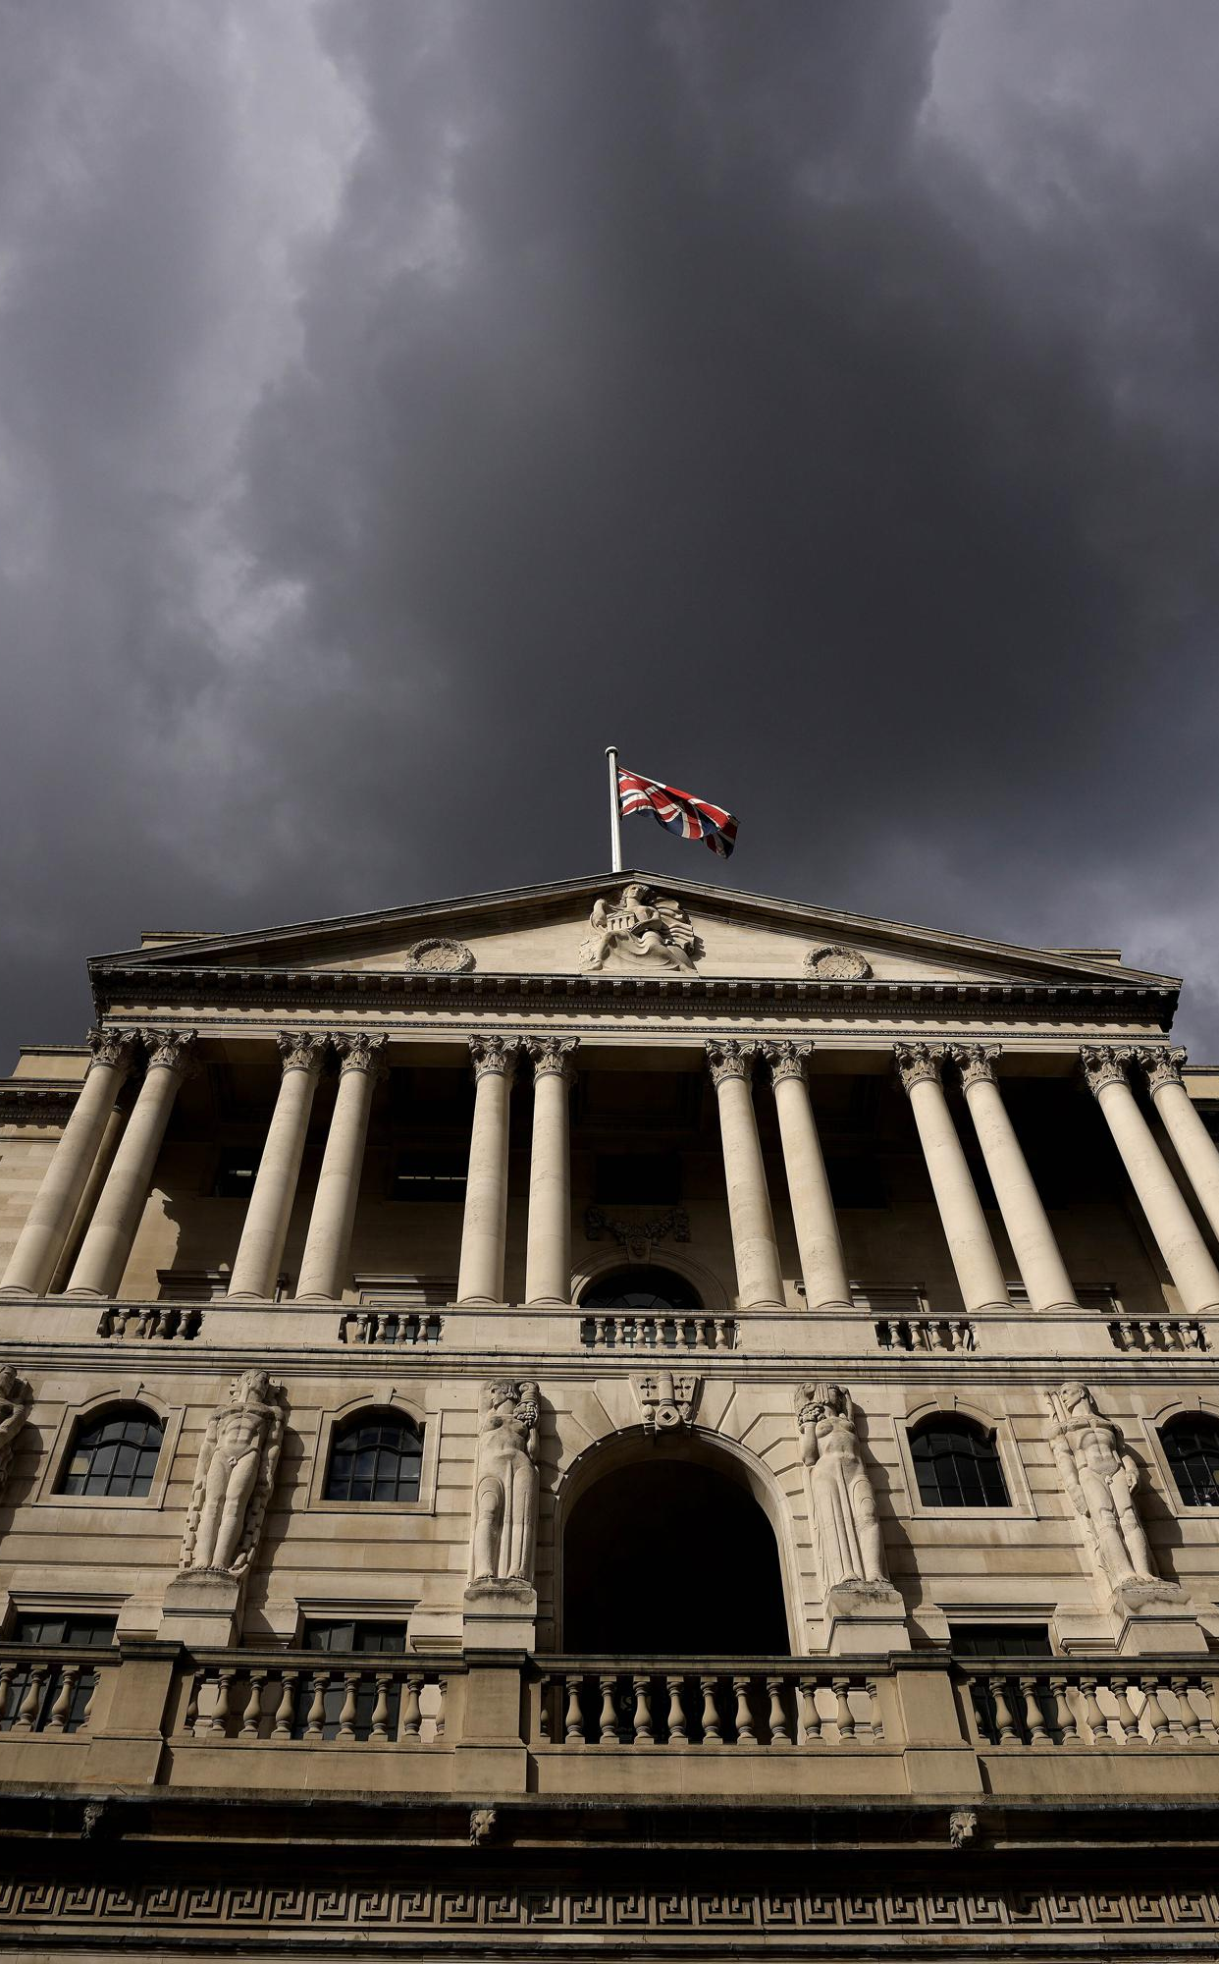
Bank of England
The Bank of England is the central bank of the United Kingdom and the model on which most modern central banks have been based. Established in 1694 to act as the English Government's banker and debt manager, and still one of the bankers for the Government of the United Kingdom, it is the world's eighth-oldest bank.
The Bank was privately owned by stockholders from its foundation in 1694 until it was nationalised in 1946 by the Attlee ministry. In 1998 it became an independent public organisation, wholly owned by the Treasury Solicitor on behalf of the government, with a mandate to support the economic policies of the government of the day,but independence in maintaining price stability.In the 21st century the Bank took on increased responsibility for maintaining and monitoring financial stability in the UK, and it increasingly functions as a statutory regulator.

Slide 16
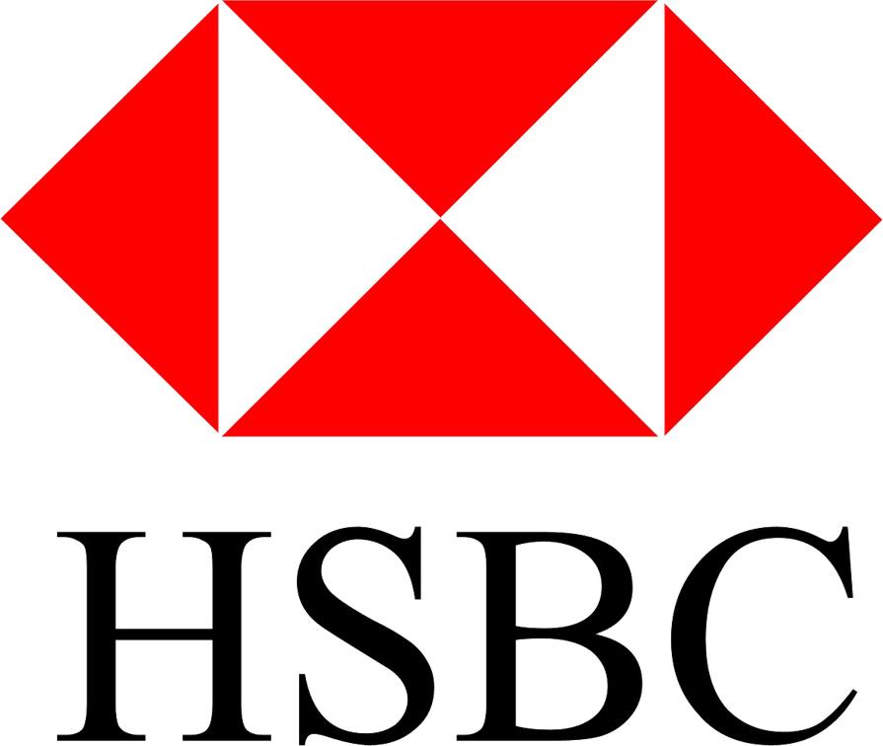


Commercial banks of England:
HSBC Holdings
It is the largest Europe-based bank by total assets, ahead of BNP Paribas, with US$2.953 trillion as of December 2021.
Lloyds Banking Group
It is one of the UK's largest financial services organisations, with 30 million customers and 65,000 employees.
Barclays
Barclays operates as two divisions, Barclays UK and Barclays International, supported by a service company, Barclays Execution Services.

Slide 17
Comparison of the monetary and banking systems of England and Pridnestrovian highlights significant differences in their organisation and functioning. England, with its developed financial infrastructure and large financial centres, represents a modern and powerful system supporting the global economy. Whereas Pridnestrovian, facing the challenges of unrecognised status and limited resources, seeks to develop its own monetary system that would reflect the interests of the region.
The presentation was made by Daniil Polozyuk, a student of group 215

